Slide 1
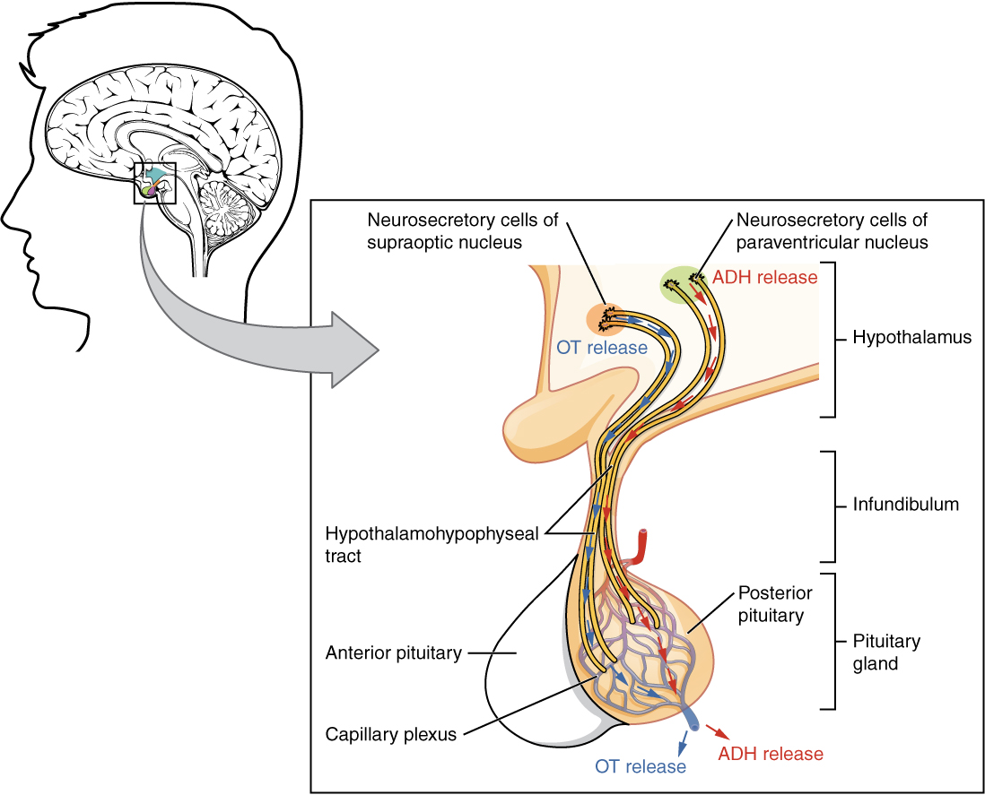
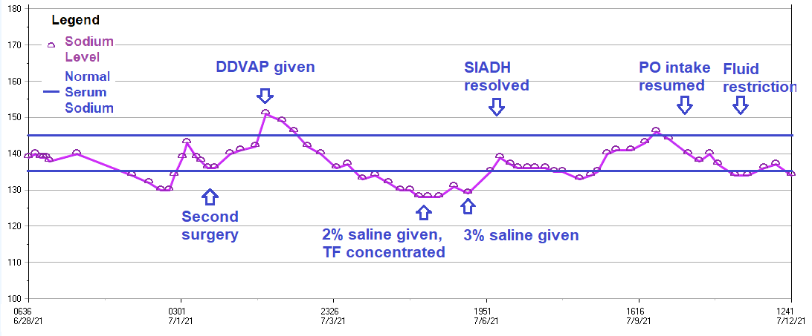
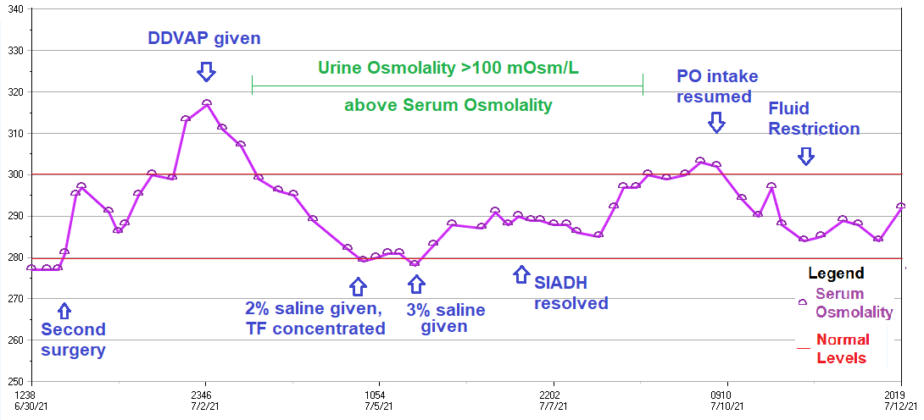
DISORDERS OF FLUID BALANCE IN A PATIENT WITH A RESECTED PITUITARY TUMOR
Maryann Ruiz, Natalia Groat RD
Introduction
Case Presentation
Course and Management
Diagnostic Criteria and Management
Pituitary tumors and surgery can disrupt pituitary function resulting in inappropriate secretion of pituitary hormones.
This can lead to disorders of sodium and fluid balance including diabetes insipidus (DI) and syndrome of inappropriate antidiuretic hormone (SIADH).
After surgery for a pituitary tumor, both transient DI and SIADH are common. They can occur individually or as a biphasic response. In a biphasic response, DI occurs first followed by SIADH.
A 67 year old female with a history of a pituitary mass and baseline vision loss presented to an outside hospital with an altered mental status and increased vision loss. She was found to have a reoccurrence of a pituitary mass which compressed the optic nerve and caused hyponatremia (serum sodium at 114 meq/L). The patient was transferred to Harborview Medical Center (HMC) for treatment.
The plan of treatment at HMC included a 2-stage surgery completed on pre-operative day 3 and post-operative day 0 to remove the mass. The patient was somnolent in the initial nutrition assessment and required enteral nutrition.
NUTRITION ASSESSMENT
Energy requirements: 1676 – 1956 kilocalories
(basal energy requirement x stress factors 1.2 – 1.4)
Protein requirements: 95 – 126 grams protein
(1.5 – 2 grams per kilogram body weight).
INITIAL ENTERAL NUTRITION
Promote at 80 milliliters per hour
Provided 1920 kilocalories, 120 grams of protein and 1611 milliliters of free water
After the second surgery, the patient displayed a classic biphasic response. See Graphs 1 and 2 for timeline.
DI Event: Initially patient began to display DI-like symptoms with sodium increased to 151 meq/L and low urine osmolality.
Treatment: She was given DDVAP which corrected her urine output and sodium by post-operative day 2.
SIADH Event: Sodium began to trend down in a manner consistent with SIADH, and the patient reached a sodium level of 128 meq/L on post-operative day 5.
Treatment: The patient was given hypertonic saline and enteral feeds were concentrated to reduce fluids.
CONCENTRATED ENTERAL NUTRITION
Osmolite 1.5 at 50 milliliters per hour + 2 Prosource protein supplements
Provided 1920 kilocalories, 105 grams of protein and 914 milliliters free water
Resolution: As the serum sodium levels normalized, the patient’s alertness improved. The patient was able to take food by mouth by post-operative day 10. Despite the SIADH resolution, mild hyponatremia persisted and the patient was maintained on salt tablets and a fluid restriction.
CONDITION | DIABETES INSIPIDUS | SYNDROME OF INAPPROPRIATE ANTIDIURETIC HORMONE
DIAGNOSTIC CRITERIA | Serum sodium: >145 mmol/L Urine osmolality: <300 mOsm/kg | Sodium serum: <135 mmol/L Plasma osmolality: <275 mOSm/kg Urine osmolality: >100 mOsm/kg over serum osmolality Normal blood volume Urine sodium: >30 mEq/L
CLINICAL MANAGEMENT GUIDELINES | Replace free water losses Administer hormone analog d -deargino-vasopressin (DDVAP) | Fluid restriction Hypertonic saline administration Salt tablets
Discussion
Management of DI and SIADH requires the expertise of an interdisciplinary team.
There are no standards to guide dietitians in the recommendation of enteral feeds either before or after pituitary tumor surgery.
Since disorders of fluid balance are common after pituitary surgery, concentrated enteral formulas may be the best strategy in order to allow more flexible fluid management by the care team.
Fluid restrictions are standard treatment in SIADH, but free water restriction could also be a viable treatment. More research should be done into the best restriction for management of SIADH.
Graph 1: Serum Sodium
Graph 2: Serum Osmolality
Sodium Level (mEq/L)
Pre-operative day 3 through post-operative day 11
Osmolality (mOsm/L)
Pre-operative day 1 through post-operative day 11
IMAGE 1: Pituitary gland structure. Pituitary tumors can be removed in several ways. All of these methods and the tumor itself can damage the cells that transport and release hormones.
Illustration from Anatomy & Physiology, Connexions Web site. http://cnx.org/content/col11496/1.6/
Definitions: DI and SIADH
References
Diabetes insipidus (DI) has low antidiuretic hormone secretion resulting in increased hypotonic urine output and hypernatremia.
Syndrome of Inappropriate Antidiuretic Hormone (SIADH) had increased antidiuretic hormone that leads to hyponatremia in the setting of increased urine osmolality.
1. Surgery for Pituitary Tumors. American Cancer Society. Published November 2, 2017. Accessed July 13, 2021. https://www.cancer.org/cancer/pituitary-tumors/treating/surgery.html
2. Mitchell-Brown F, Stephens-DiLeo R. Managing panhypopituitarism in adults. Nursing2021. 2017;47(12):26-31. doi:10.1097/01.NURSE.0000526883.02682.22
3. Harrois A, Anstey JR. Diabetes Insipidus and Syndrome of Inappropriate Antidiuretic Hormone in Critically Ill Patients. Crit Care Clin. 2019;35(2):187-200. doi:10.1016/j.ccc.2018.11.001
4. Lamas C, del Pozo C, Villabona C. Clinical guidelines for management of diabetes insipidus and syndrome of inappropriate antidiuretic hormone secretion after pituitary surgery. Endocrinol Nutr Engl Ed. 2014;61(4):e15-e24. doi:10.1016/j.endoen.2014.03.010
5. Edate S, Albanese A. Management of Electrolyte and Fluid Disorders after Brain Surgery for Pituitary/Suprasellar Tumours. Horm Res Paediatr. 2015;83(5):293-301. doi:10.1159/000370065
6. Simon EE, Hamrahlan S, Teran F. Hyponatremia Treatment & Management: Approach Considerations, Medical Care. Medscape. Published June 17, 2019. Accessed July 15, 2021. https://emedicine.medscape.com/article/242166-treatment#d9
Graph 1 Serum Sodium: Serum sodium is a diagnostic criteria for both DI and SIADH. In the graph, the patient's sodium level can be seen to increase during the DI period of the biphasic response and the decrease during the SIADH period. Although the DI and SIADH were considered resolved shortly after treatment, the patient continued to struggle with appropriate fluid balance.
Graph 2 Serum Osmolality: Serum osmolality is not a direct diagnostic criteria for DI, but it does reflect the hypernatremia. In SIADH, the difference between the serum and urine osmolality is one of the diagnostic criteria. In this graph, the period in which the urine osmolality is more than 100 mOsm/L greater than the serum osmolality is indicated by the green bar above the plotted points. This indicator reflects inappropriately concentrated urine.
Notes:
Top banner must remain the same.
Feel free to customize to your needs.
Must download all fonts:
Encode Sans (.zip)
Encode Sans Family (.zip)
Uni Sans (.zip)
Open Sans (.zip)
Open Sans Family (.zip)

