Slide 1
Farm to Table
Design Project
REPORT PREPARED BY UNIVERSITY OF WASHINGTON
MS/MPH STUDENTS
NUTRITION 531, PUBLIC HEALTH NUTRITION
WINTER 2020

Slide 2
Introduction

Slide 3
Introduction - Why This Matters
Food insecurity in Seattle:
13% of adults
51% of low-income households with children
Various groups are disproportionately affected
The “food security gap” - those not eligible for food assistance
Affects about 13,000 Seattle residents
Increasing availability of food in early care and education centers may help bridge this gap
Notes:
First we wanted to start off talking about why this program is important
In Seattle, as of last year, food insecurity affected 13% of adults, and 51% of low-income households with children, and this has been shown to disproportionately affect various groups, including low-income households, people of color, those in lower educational brackets, and those in the LGBTQIA+ community.
Additionally, there’s a subset of folks who fall within a “food security gap,” where they are not eligible to receive food assistance but still experience food insecurity.
The F2T program was created as a way to help address food inequities in Seattle, by increasing access to food in early care and education centers that predominantly serve low-income households. This program also has the added benefit of bolstering the local economy by increasing business for local farmers.
I’d like to clarify here that these locations are referred to in a variety of ways (early care and education centers, early learning environments, etc.) but for this presentation, we will be referring to them as early learning centers or just centers.
Bolt K, Carter L, Casey D, et al. Healthy Food Availability & Food Bank Network Report. Report for City of Seattle and Seattle City Council.; 2019.

Slide 4
Introduction - Background
The City of Seattle Farm to Table program provides funding, technical assistance, and education support for early care and education centers
Engages 5 partners: Farmstand Local Foods, City of Seattle Human Services Department, Nourishian for Life, Tilth Alliance, and Solid Ground
The program is funded by revenue from the city’s 2017 Sweetened Beverage Tax
Notes:
The program is designed to provide funding, technical assistance, and education support for early learning centers. These centers are provided funds through the program, and they can use these funds to purchase foods from local farmers through an online marketplace; this procurement process is carried out by Farmstand Local Foods.
The program also involves technical support in the form of staff training as well as menu planning, lesson planning, and cooking instructions, and this is carried out by Nourishian for Life
The educational support comes in the form of gardening assistance, cooking demonstrations, and farm field trips, and this is carried out by Solid Ground and Tilth Alliance
The program is comprised of this group of partners, along with City of Seattle Human Services Department and the early learning centers, of which, there are 64 currently participating in the program
Additionally, the Sweetened Beverage Tax was passed in Seattle in 2017, and the Farm to Table program is fully funded by the revenue from that tax.

Slide 5
Introduction - The Design Project
A steady revenue stream allows the program to re-envision how to better serve its community
This phase assists with data collection to help guide development of the program
These efforts have helped create a list of recommendations for program implementation
Notes:
The steady revenue from the tax has allowed the Farm to Table program to reconsider how it can best serve its community, and the Design Project is essentially a means to do this.
Our group was tasked with data collection to begin informing the process of how this program might be developed, and from that, we’ve created a list of recommendations regarding program implementation, in hopes that it will help guide future funding, program activities, program evaluations, and policymaking

Slide 6
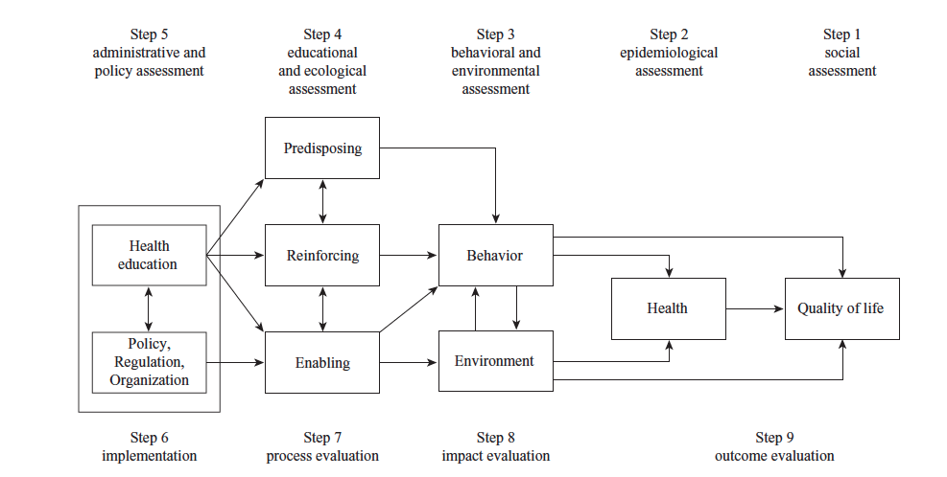
Introduction - The PRECEDE-PROCEED Model
Crosby & Noar, 2011
Notes:
The Design Project will use the PRECEDE-PROCEED model to guide development using an ecological approach. The idea is that rather than deciding on a plan of action and sort of seeing how that shakes out, you first identify what you want to accomplish and work backwards to come up with a way to meet that goal.
There are two main phases--planning & evaluation
The PRECEDE portion of the model covers the social, epidemiological, behavioral and environmental, and educational and ecological assessments (represented here as steps 1-4)
The PROCEED portion consists of administrative and policy assessment, implementation, and process, impact, and outcome evaluations (which are steps 5-9)
Our group carried out the early phases of assessment (steps 1-3) focusing on the social, epidemiological, behavioral, and environmental aspects.
Step 1 allowed us to capture how parents and early learning center staff define healthy food and healthy food access, as well as how they define a successful and equitable program
Step 2 allowed us to identify what outcomes this community would like to see the Farm to Table program achieve and what challenges arise in getting the program to be successful, as defined by the community in step 1.
Finally, in step 3 we identified potential actions that could help achieve the desired program outcomes and used these to formulate our recommendations for program development
Crosby R, Noar SM. What is a planning model? An introduction to PRECEDE-PROCEED. J Public Health Dent. 2011;71(SUPPL. 1). doi:10.1111/j.1752-7325.2011.00235.x

Slide 7
Methods

Slide 8
Methods - Data Sources
Phone Interviews:
Early care and education center staff
Parents/Families
Literature Review:
Analyze academic and grey literature on farm to early care and education
Program Outreach
Phone interviews with farm to early care and education programs around the country
Notes:
We collected our data from four sources:
We conducted interviews with staff members who are part of centers who receive F2T programming, and with family members of children who receive F2T programming
Those who gave their time by participating in an interview were compensated with a $50 gift card
We also conducted a literature review where we analyzed both academic and “grey” literature - meaning both journal articles as well as things like reports or program evaluations.
Additionally, we reached out to programs around the country who are also engaged in some form of farm to ECE work.
The literature review team took that time to read both traditional and “grey”, meaning documents like program evaluations or reports, as well as reach out to organizations involved in Farm to ECE work around the country.
We then compiled all of our findings, and shared them as a class. We deliberated as a group, and then the following week, we came back together to discuss proposed recommendations.

Slide 9
Methods - Data Collection
Family & Staff interviews - main focus:
How does the participating community define “healthy food” and “healthy food access”?
What does a successful food access program look like?
What supports are needed to achieve a successful program?
Literature review & program outreach - main focus:
What are the social, economic and health impacts of farm to early care and education programs?
What have been the successes, challenges and barriers to implementation?
How have these challenges/barriers been overcome?
Notes:
In order to collect our data, we split off into three teams:
A parent/family interview team
An ECE staff interview team
A literature review team
Family and staff interview focus:
How what does healthy food and healthy food access mean to those who are receiving F2T programming?
What does a successful food access program look like - really wanted to be hearing the input and voices of those who are actively participating
Particularly for the staff - what sorts of support do they need to be able to implement a successful program?

Slide 10
Methods - Example Questions
Early Care and Education Staff Interview:
What types of foods would you like to see the Farm to Table program make available to you to purchase for your program?
Parent/Family Interview:
Are there any food items that are culturally important to you that you would like to see served to your children?
Program Outreach:
How do you measure changes in behavior in and outside of child care setting? What kind of impact have you seen?
Notes:
To give you a sense of the types of questions that we were asking, here are a few examples. The goal here was really to gather input from the participating community about what they want to see in this type of program.
In conversations with other programs, we were also curious to learn how they measure success and changes in behavior, and how those impacts have manifested.
The interviews themselves were conducted in pairs, and each interview was recorded given consent from whoever we interviewed.
While one person asked the questions, the other operated the recorder and also took detailed notes during the process
Next slide

Slide 11
Data Analysis - Phone Interviews
Step 1: Conduct a phone interview with a family or staff member
Step 2: Thoroughly review interview notes and recording
Step 3: Create a detailed summary, capturing direct quotes that were illustrative of key themes
Step 4: Create a “master” summary, reflecting major findings of all interviews
Key focus: eating patterns, culturally relevant foods, challenges and benefits of fresh and/or local foods, challenges and benefits of F2T
Notes:
This brings me into how we analyzed all of our data. The following steps were completed for each phone interview
The detailed summaries were not quite a direct transcript, but were almost word-for-word, and again, we took care to capture major themes, ideas, and concerns.
To really answer those main focus questions, we asked about eating patterns in centers and at home, about the importance of culturally relevant foods, challenges and benefits of serving fresh and/or local foods both at home and at the centers, and any challenges faced and benefits gained from working with F2T.

Slide 12
Data Analysis - Program Outreach
Step 1: Conduct a phone interview with a farm to early care and education program
Step 2: Thoroughly review interview notes and recording
Step 3: Create a detailed summary capturing key themes
Step 4: Create a “master” summary, reflecting major findings of all interviews
Key focus: program challenges and successes, solutions, funding, success measurements, incorporating community voice, and definitions of “local” and “sustainable”
Notes:
The folks who were on the lit review team followed an almost identical process with their phone interviews, however they did not capture direct quotes in their detailed summaries.
They also had a different focus, and their goal was to gather insight and advice from other programs engaged in this space.
Their questions centered around challenges and successes, solutions to challenges, funding, metrics, incorporating community voice, and how other programs define “local” and “sustainable” food

Slide 13
Data Analysis - Traditional Literature Review
Step 1: Read traditional and grey literature review sources
Step 2: Document methods, results, discussions, next steps and answers to the main research questions
Step 3: Quantify the top impacts of farm to early care and education
Step 4: Create a “master” summary, reflecting key themes, top impacts, barriers/challenges and possible solutions as presented in the literature
Key focus: major social, economic and health impacts of farm to ECE, successes, challenges/barriers to program implementation, solutions
Notes:
This brings me into how we analyzed all of our data. The following steps were completed for each phone interview
The detailed summaries were not quite a direct transcript, but were almost word-for-word, and again, we took care to capture major themes, ideas, and concerns.

Slide 14
Methods - Results & Recommendations Process
Results meeting
All students and instructors met to discuss results
First draft of recommendations created
Recommendations meeting
All students and instructors met to discuss first draft of recommendations

Slide 15
Literature Review

Slide 16
Literature Review
Evidence Types
Type 1, Experimental: Randomized experimental or interventional, meta-analysis, quasi-experimental
Type 2, Observational: Evaluation data, pre-post intervention data, observational data, qualitative methods
Type 3: Position paper, grey literature
Type 4: Non-traditional literature review source
Literature Breakdown
Type 1: 10 sources
Type 2: 9 sources
Type 3: 10 sources
Type 4: 7 sources
Photo courtesy of Centers for Disease Control and Prevention
Notes:
Traditional literature: studies and papers
Non-traditional: interviews with similar programs
Grouped literature into 4 categories which we will use to indicate where evidence in this presentation was taken from

Slide 17
Literature Review
What Farm to Early Learning Centers Exist Nationally?
Colusa Indian Community Hand in Hand Learning Center Colusa County, CA
Growing Minds Appalachian Sustainable Agriculture Project Farm to School Program Asheville, North Carolina
Harvest for Healthy Kids Portland, Oregon
Little Ones Childcare Forest Park, Georgia
North Carolina Farm to Early Care and Education Raleigh, North Carolina
Sunrise Project Lawrence, Kansas
Wake County Smart Start Raleigh, North Carolina

Slide 18
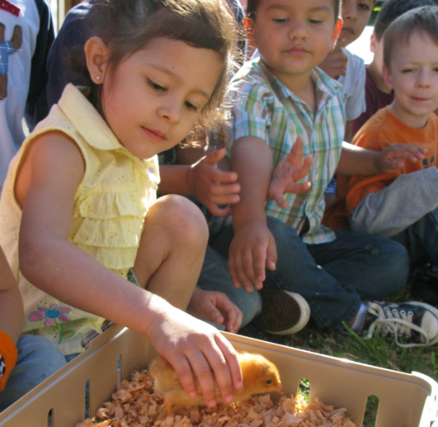
Literature Review
Farm to Early Care and Education Overview
A growing movement with nationwide presence
A model comprised of three core components:
1) Local food sourcing
2) School-based gardens
3) Food and agricultural education
Why Farm to Early Care and Education?
Diet quality, healthy behavior change
Young children spend a significant amount of time within the early learning center environments
Can be adapted to any population
Economic growth for farmers
Photo courtesy of National Farm to School Network
Notes:
According to the National Farm to School Network, Farm to ECE is a growing national movement. Early child education centers that employ Farm to ECE programming usually incorporate one or more of the three components of Farm to ECE.
**Please remember to clarify what ECE means if you will be using the acronym throughout your part of the presentation

Slide 19
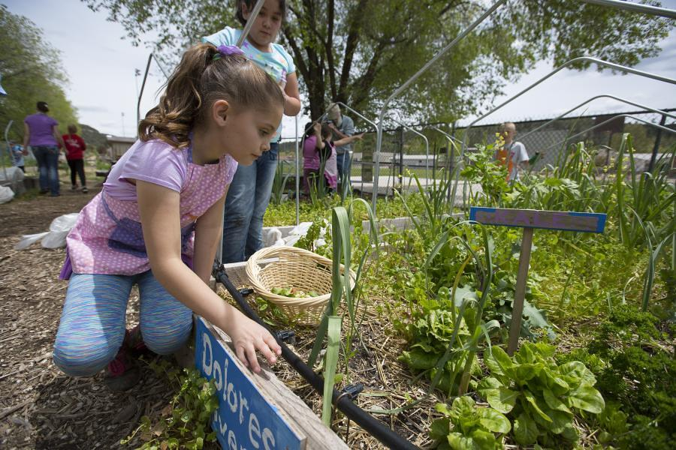
Literature Review
Impacts of Farm to Early Care and Education
Increased knowledge of and willingness to try new foods^{1,2,3}
Improvements in diet quality, notably with fruit and vegetable intake^{1,2,3}
Relationships between key stakeholders^{1,2,3}
Economic opportunity for farmers³
Photo courtesy of Flickr, labeled for non-commercial reuse
Literature Key:
1 - Experimental evidence 3 - Position papers & grey literature
2 - Observational evidence 4 - Non-traditional literature
Notes:
Impacts ordered by magnitude of impact
Increased knowledge and willingness: achieved with exposure to farm and garden environments and taste tests
Relationships: stakeholders include families, educators, farmers and wider community
Economic opportunity for farmers: goal is to strengthen local food system. Experimental and some observational data indicate low and/or modest economic gain for farmers. Nonetheless, it is a goal of the farm to early learning center, model, especially highlighted by the National Farm to School Network

Slide 20
Literature Review
Challenge 1: Lack of resources such as time, labor, training, knowledge, and funding^{1,2,3,4}
Use established curriculum^{1,2,3}
Collaborate with subject matter experts^{1,2,3,4}
Cut costs during procurement³
Provide ongoing training for teachers and staff^{2,3,4}
Challenge 2: Program participation and engagement among parents and children^{1,2,3,4}
Use active curricula developed for children^{1,2,3,4}
Engage parents with a variety of communication^{1,2,3,4}
Photo courtesy of Harvest for Healthy Kids, www.harvestforhealthykids.org
Literature Key:
1 - Experimental evidence 3 - Position papers & grey literature
2 - Observational evidence 4 - Non-traditional literature
Notes:
Not exhaustive list, report has more info
Introduce slide by describing format: challenge presented in lit and corresponding solutions
Challenge 1
Curriculum = Color me healthy, Harvest for Healthy Kids, Watch Ge Grow
SMEs = RDs, master gardeners, Cooperative Extension
Procurement - Gleaning, buying surplus produce, canned veggies
Teaching techniques and food prep training; bonus, promotes center-wide buy-in
Challenge 2
Engage parents: emails, texts, recipe cards, newsletters, flyers

Slide 21
Literature Review
Challenge 3: Reliability, economic feasibility, and logistics with local procurement^{1,2,3,4}
Strategic partnerships for procurement^{2,3}
Prioritize relationship with farmers^{2,3,4}
Consider alternate food procurement and preparation strategies⁴
Challenge 4: Structural barriers from lack of system-wide investment or health-promoting policies^{2,3,4}
Encourage local and state policies that incentivize Farm to early learning centers^{3,4}
NFSN tool for addressing injustice and racism³
Photo courtesy of National Farm to School Network
Literature Key:
1 - Experimental evidence 3 - Position papers & grey literature
2 - Observational evidence 4 - Non-traditional literature
Notes:
Challenge 3
Strategic partnerships: grocery stores, CSA, farm shares
Alternate strategies example: central kitchen, allows small centers to pool resources and reduces burden on storage capacity and time constraints for food prep at center
Challenge 4
National Farm to School Network, offers a tool that helps organizations assess their impact and/or contributions to structural oppression

Slide 22
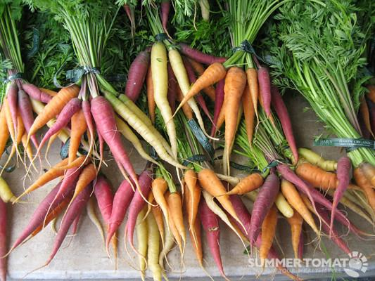
Literature Review
Challenge 5: Seasonality of produce^{1,2,3}
Educate staff, parents, and children on seasonal availability^{2,3}
Procure non-produce items³
Challenge 6: Unwillingness to try new fruits and vegetables (neophobia)^{1,2,3}
Repeated exposure with taste tests^{1,2,3}
Challenge 7: Communication with stakeholders (farmers, distributors, staff, and educators)^{1,2,3,4}
Prioritize relationship-building with farmers and other stakeholders^{1,2,3,4}
Hire coordinator to facilitate communication^{3,4}
Photo courtesy of Flickr, labeled for non-commercial reuse
Literature Key:
1 - Experimental evidence 3 - Position papers & grey literature
2 - Observational evidence 4 - Non-traditional literature
Notes:
Allie Seroussi
Challenge 5
Non-produce items: meat, milk, grains, legumes
Challenge 7
Relationships and collaborations: empower stakeholders as change agents and promotes buy-in for program

Slide 23
Family & Parent Interview Results

Slide 24
Results: Family & Parent Interviews
Parents Interviewed | 7
Early Care and Education Centers | Wing Luke Tiny Tots ReWa Lake City Early Learning Center Launch Miller Annex Arc Northgate
Main Takeaway | Lack of knowledge of the Farm to Table Program
Notes:
We conducted 7 parent phone interviews.
Each parent had at least one child attending one of the Farm-to-Table-participating childcare centers listed in this table
These centers represent various socioeconomic backgrounds.
I will provide details on our findings, but the biggest takeaway and most consistent comment across interviews was a general lack of awareness and knowledge of the Farm to Table program.

Slide 25
Results: Family & Parent Interviews
Overarching Themes:
Parents define “healthy food” as varied, energizing, and abundant in fruits and vegetables
Parents face common barriers to accessing and serving healthy food
Parents confused the Farm to Table and Good Food Bags programs
Farm to Table success requires increased parent involvement
Notes:
In analyzing the interview transcripts, we identified many common points, and several overarching themes emerged.
Among the parents interviewed: (read each)

Slide 26
Defining Healthy Food
“I like to keep things within the rainbow if possible. Healthy. Getting fiber, vitamins, minerals, and they are fantastic for your body and keep you going.”
Notes:
These two quotes are pretty representative of how the parents defined healthy food.
Read quotes

Slide 27
Defining Healthy Food
Qualities of Healthy Food
Varied
Energizing
Nutritious
Minerals
Vitamins
Protein
Low in Sugar
Low in Salt
Plant-based (i.e., fruits and vegetables)
Notes:
Overall, parents defined healthy food as varied, energizing, and nutritious.
In terms of variety, a few parents pointed out that their kids are “picky eaters.” These parents worried that if a variety of options are not presented to their child, they may not eat at all
When describing what makes food “nutritious” parents said that minerals, vitamins, and protein are important components
Additionally, parents valued fruit and vegetable intake and sought to curb their childrens’ intake of sugar and salt. However, knowledge of why fruit and vegetable intake is important, or why avoiding salt or sugar is a good idea, was limited.
The parents we spoke with regularly prepare meals at home; or have a family member who regularly cooks
However, despite a common desire to feed their children healthy food, many families faced barriers to do so

Slide 28
Access to Healthy Food
“The seasonality. I know that not everything is grown at the same time.”
“Some things take prep and I may not have the time or ability to do that prep.”
“I’m a single mom of four. Every kid needs their own time with you at some point; there’s so many other needs to be met beyond just providing their food.”
Notes:
These three quotes represent the most frequently raised barriers to accessing healthy food
(Read them)

Slide 29
Access to Healthy Food
Common Barriers
Cost
Seasonality
Time
Perishability
Preparation
Notes:
Cost of food, especially fresh produce, was cited as a barrier to accessing healthy food
Seasonality was also cited by many as limiting their ability to provide a diverse diet to their kids
Time was another commonly raised issue - from time spent grocery shopping, to the time required to prepare the fresh items. One parent mentioned that she often purchase fresh foods just to watch them rot before she has a chance to prepare them
Finally, a lack of knowledge of how to prepare certain foods, or how to prepare them in a palatable, “kid-friendly” way limited families’ access to healthy food

Slide 30
Farm to Table Knowledge
Confusion with the Good Food Bags program
Perceived lack of communication
Interest in opportunities for parent/family involvement
Notes:
Unfortunately, parents were unaware of the Farm to Table program and its mission to increase access to healthy food
Nearly every parent we interviewed initially confused the Farm to Table program with the Good Food Bags program
Because the Good Food Bags go home with children, parents were more aware of this program
Parents also commented on how much they enjoy the Good Food Bags program because it directly enables families to prepare healthy food at home
In contrast, parents cited a lack of communication regarding the Farm to Table program
However, once they learned what the Farm to Table program offers, all parents expressed excitement and an eagerness to become more involved

Slide 31
Farm to Table Opportunities
“Any program looking to have a real positive effect on families, it’s important to incorporate the entire family into the message. It’s kind of a lost cause to give a kid a meal and say ‘Hey, this is delicious right?’ without getting buy-in from the parents to be supportive of the healthier choices and making those changes in the house.”
Notes:
Given the dearth of knowledge of the Farm to Table program, most of the parents’ recommendations for the program were focused around increasing awareness
Additionally, parents felt that family engagement, beyond just awareness, was critical to success.
This parent said (read quote)

Slide 32
Farm to Table Opportunities
Program reach
impact eating at home
cover gaps in food security over school breaks
Parent involvement
communication/outreach
take-home components
Measurable outcomes
illustrate purpose/increase buy-in
Notes:
Overall, parents raised three main opportunities for Farm to Table
First, they believe a successful program will have a greater reach, to impact eating at home
A couple parents also hope that the program can somehow address the gaps in food security that occur over school breaks and weekends
Second, and related, they believe that increased communication and outreach to connect and engage the parents is critical to program success
Finally, parents suggested that a successful program would have measurable outcomes that can illustrate the purpose of the program and further increase buy-in

Slide 33
Farm to Table Opportunities
“Success would be the kids getting fresh fruits/vegetables that are locally grown and getting introduced to new fruits and vegetables; farmers/growers getting supported; childcare centers getting better reviews because they’re serving healthy/local foods; and parents are happy because their children are eating well.”
Notes:
Parents’ vision of a successful program will positively impact all stakeholders
As this parent put it, read quote

Slide 34
Early Care & Education Center Staff Interview Results

Slide 35
Results: Early Care & Education Center
Staff Interviews
Total number of staff members interviewed | 9
Number of children attending each center | 12-350
Ages of children at each center | 1 month - 13 years
SES | The majority of centers served low income communities; some centers had a mix of high and low SES
Number of sites per center | 1-12
Number of meals served at each center | Varies
Food and nutrition curriculum available? | Varies
Notes:
First, we have some quick statistics that we would like to share. We just want to note that these statistics only refer to the sites where we spoke to staff members and it may not be reflective of all of the sites that participate in the Farm to Table program.
There were a total of 9 staff members interviewed
The number of children attending each center varied from 12 to 350.
The ages of the children also ranged from 1 month to 13 years
Many of the children that these sites serve are from low SES families, but a few centers had a mix of children from high and low SES families
There was also a lot of variation in the number of sites that each center had. Some only had 1 site while others had up to 12 sites at which they served children from different communities around seattle

Slide 36
Results: Early Care & Education
Staff Interviews
Overarching themes:
Barriers to accessing and serving fresh foods
Challenges to participating in the Farm to Table program
Activities and supports needed from the Farm to Table program
Notes:
After speaking with the staff members, there were a few main themes that surfaced:
The centers face a lot of barriers to accessing and serving fresh foods
Given the differences in culture between centers, the barriers that each center faced were varied and we highlighted the most common ones.
There are also various challenges to participating in the Farm to Table program. The most notable one that we encountered is a lack of knowledge about the Farm to Table program. Many staff reported that they did not know about the program until they were in a position to order food
The centers need more activities and support from the Farm to Table program.

Slide 37
Barriers to Accessing and Serving Fresh Foods
Staffing and food preparation
Menu planning and menu requirements
Seasonality
Food storage and food waste
Delivery timing
“Menu planning [makes it difficult to serve fresh foods] because you don’t know what will be offered from Farm to Table more than a week in advance because you order throughout the week and it comes to you on Tuesdays. If what you plan in your menu is not reflected or something along those lines...that can be frustrating.”
“It’s pretty hard to store pounds and pounds of lettuce...It does come in bulk and we do have to order so much of it. Even if we only order $100 of one thing it either sits on the table or takes up the whole freezer. Two hardest things are storing it and planning to cook it.”
Notes:
These are the most common barriers that we observed after talking to staff members.
Staffing and food preparation
Many centers are understaffed and don’t have a person designated to cook and serve the fresh foods provided by farm to table to the children. Often times, the staff members need to be supervising the kids in order to maintain the proper supervisor to child ratio. As a result, it is very difficult to pull a staff member away to help prepare and serve food
A few centers expressed a desire for more pre-prepared food options or value added items in order to get around the issue of not having enough time to prepare the foods from scratch
Menu planning and menu requirements also surfaced as a barrier for many centers
Some centers plan their menus up to a month in advance and are not able to repeat meals within a certain time period
But because the centers do not know what will be available through Farm to Table until a week in advance, this makes it difficult to know what to plan if they don’t know what will be available
All centers also have to adhere to CACFP standards - also makes it difficult to order food because they don’t know what will be available and they do not know if the available foods will comply with CACFP
Seasonality also came up as a challenge for many centers because many of the centers reported that the children tend to prefer summer fruits and berries, but many of the centers are not open during the summer. In addition, the staff reported that it is harder to menu plan in winter months because there’s generally less variability in the foods available
The next big issue that we observed was food storage and food waste
The current delivery minimum amount is $100. For smallr centers serving less than 15 children, it is very difficult for them to meet this order minimum and not waste the food that is getting delivered
Many centers also do not have enough storage capacity to store $100 worth of fresh food. Some of them don’t have freezers that they can store fresh foods in, and others simply don’t have enough space to put the food.
Similar to the staffing and food preparation challenges, a few centers expressed a desire for more value added or prepared foods to help them get around the storage issue.
The last main problem that we observed was delivery times - sometimes the delivery times don’t align with the center’s schedules and it’s hard for them to find the capacity to fit or accept the foods ordered becuase they may be understaffed that day or they simply don’t have the storage capacity to hold all of the food delivered
These quotes help to sum up the challenges that the centers are currently experiencing:
Despite the challenges, the staff try their best to get food to kids. If we could go to the next slide, there are some great quotes that sum up the staff’s efforts

Slide 38
“A lot of [the kids] rely on school lunches too and I want them to be happily fed if they go home and there’s not much for dinner that day. It’s not always that desperate but you don’t know when it is.”
“[Serving local foods to children is] very important - we have many low income families. When we provide them organic and healthy foods, they really appreciate it. When we talk about Farm to Table they like the program and the benefits.”
Notes:
So, the staff are doing the best with the resources they have, and many of them have expressed appreciation for the program. However, they do still need additional support in order for them to make sure that the Farm to Table program can reach its full potential.

Slide 39
Challenges to Participating in the Farm to Table Program
Staff do not know about Farm to Table or its goals until they directly interact with Farm to Table
Challenges with additional services provided by the program
“I would say, probably [a challenge to participating is] just the knowledge and knowing how to get started. You know, it kind of might sound overwhelming, or [you] don’t know [how to] access [Farm to Table].”
“Last year [one of Farm to Table’s partner programs] came out and did some lessons and tried to correlate with curriculum and they wanted to do one hour lessons and that was, I don’t know if it’s because of government funding or what but for preschoolers, a one hour lesson is not good. Even a half hour is very, very long. That’s the only thing I had issues with.”
Notes:
The next theme that we encountered involved the various challenges that centers faced when it came to participating in the Farm to Table program
The main challenge that we observed was that staff members overwhelmingly indicated they do not know enough about the Farm to Table program.
Of the 9 staff members that we interviewed, 8 of them did not learn about the program after they stepped into a role for which they were responsible for the Farm to Table ordering and organization within their site. This general lack of knowledge or understanding within the sites has made it difficult for more staff members to participate.
The staff members also reported that there have been challenges with the additional services provided by Farm to Table. Most of these challenges have related to lesson planning and other educational opportunities.
These are great quotes that sum up what many of the centers have experienced
This leads into our final theme - the centers need more support

Slide 40
Activities and Supports Needed from the Farm to Table Program
Request for educational materials and resources
Request for more variety of food items
Request for clear communication of values and goals
“I really love what [Farm to Table] has available. What I would like to have more of is not food, but if they could provide more recipes on how to use the foods that they have available, that would be great because there are some [foods] that I have never heard of and don’t know how to serve.”
“...that’s my first time hearing the values. I think...it would be probably a beautiful thing to see those values somewhere when [the food] is coming in so that when I’m giving it to a site they can actually see [them] - I think hearing those values will change their respect for that food as they’re preparing it too...I never even knew that those were the values [of the program]...it would be beautiful to see those.”
Notes:
The three most highly requested activities and supports were additional educational materials, prepared foods, and centralized communication of values and goals.
As previously mentioned, many staff members are not familiar with Farm to Table or the foods that Farm to Table supplies. They expressed a desire for recipes or education materials that they can use to prepare the food for the children, or to teach the children more about fresh foods that they are receiving. 4 staff members specifically reported a desire for more farm outreach. This would involve either bringing farmers involved with the program in to the centers to lead an educational session or to create an established system for field trip plans
Many staff members also requested pre-prepared foods or value added foods in order to help them get around challenges related to staffing or storage
7 out of the 9 staff members also reported that Farm to Table needs to establish its values and goals in a consistent and clear manner to center staff through marketing and advertising.
These are great quotes that reflect the type of activities and supports needed by the centers. The second quote is specifically referring to the some of values of the Farm to Table program such as access to quality food, community and health equity.
With these results from the parent and staff interviews in mind, I’ll turn it over to Lexie and Anna to discuss some recommendations

Slide 41
Recommendations

Slide 42
Recommendations
Center Support: Early Care and Education Centers in Need of Support from Farm to Table Program
Parent/Guardian Involvement: Establish Parent and Guardian Involvement
Program Intentions: Evaluate Scope, Goals, and Outcome of the Farm to Table Program

Slide 43
Center Support: Early Care and Education Centers in Need of Support from Farm to Table Program
Develop personalized support system based on center characteristics
Development of center database
Centralized information about each center
Identify characteristics including: kitchen logistics, staff ratios, age range and CACFP compliance.
Adapt to each center’s specific traits
Individualized purchasing limit for each center
Dependant on center enrollment
Set dollar price per child enrolled
Addresses food waste and accessibility
Notes:
Our first recommendation is centered around the establishment of a more personalized support system for the individual centers based on their individual characteristics. This could be accomplished in two ways:
DEVELOPMENT OF CENTER DATABASE:
Due to the various individual characteristics such as kitchen logistics, staff ratios, age range and CACFP compliance involved with each center the development of a centralized database with specific information unique to each site could help create a more specialized approach for each facility.
INDIVIDUALIZED MINIMUM PURCHASES:
Underutilization of purchased produce can cause unnecessary food waste which is counter-productive to F2T mission.
It can be really difficult for some centers to hit the minimum purchase requirement of $100 due to the fact that some centers only use ingredients for snacks or educational demonstrations. Adjusting this requirement based on school enrollment through setting a set dollar price for each child enrolled in the center could help create a more sustainable model for purchasing as well as a way to decrease food waste. The excess food salvaged by this adjustment could then become accessible to other centers who could benefit from it.

Slide 44
Center Support: Early Care and Education Centers in Need of Support from Farm to Table Program
Establishment of outreach coordinator position
Provide training for center staff, organize educational opportunities, and aid with troubleshooting
Strengthen staff skills
Organize educational opportunities
Troubleshooting
Liaison between Solid Ground and Tilth Alliance
Increased support, engagement, and communication
Adoption of developed curriculum, educational material, and recipe ideas for centers and parents
Improved educational involvement
Potential curriculum: Harvest for Healthy Kids
Recipe cards to decrease waste and increase center staff efficiency
Notes:
The next recommendation we would like to propose is the establishment of a singular role for outreach within F2T. The development of this role could be beneficial in streamlining how interactions with the multiple partners and centers are developed, helping to create a more solid support system for each of the affiliates.
This role would include providing and monitoring training for teachers and cooks, organizing educational opportunities, and helping centers with trouble-shooting for ordering difficulties.
This training would include information around seasonal produce use and how to reduce food waste through effective ordering.
This coordinator would also serve as liaison between Solid Ground and Tilith Alliance.
By increasing communication with Solid Ground and Tilth in turn will create a stronger connection between F2T partners and the individual centers the program is involved with.
Many centers have indicated a high level of interest around more nutrition education and farm trips. The development of a coordinator role to streamline communication between these programs and the centers has the potential to increase these opportunities.
The development curriculum, educational materials, and recipe ideas for distribution to centers and parents can help F2T’s educational involvement with various childcare centers.
Many center staff members expressed excitement around the educational component of F2T’s mission but found there was a bit of a lack of educational materials available. Increased involvement with F2T in the form of age-appropriate curriculum, assistance with on-site gardens, and overall outreach and engagement could help fill this need effectively.
One evaluated and publicly-available curriculum that was previously identified by the traditional literature review with potential for implementation is Harvest for Healthy Kids.
The development of recipe cards available to staff is another effective way to minimize food cost and help generate ideas for use of the different types of seasonal produce.

Slide 45
Center Support: Early Care and Education Centers in Need of Support from Farm to Table Program
Expansion of Farm to Table funds
Increase funding transparency and explore other avenues of spending possibilities
Farm field trips, nutrition education, gardening, or kitchen resources
Provide centers with food preparation support
Work with food safety certified farmers to minimally process some produce for distribution to centers
Increases point of purchase and profitability for farmers
Creation of centralized kitchen
Communication with farmers about specific needs of each center
Work with farmers to increase availability of value-added and highly requested produce
Notes:
The next set of recommendations involves increased diversification around the use of funds to each center as well as services provided by F2T.
EXPANSION OF F2T FUNDS:
By allowing centers to use a portion of funds for a other resources related to F2T’s mission such as farm field trips, nutrition education, gardening or kitchen resources could help increase transparency around funding.
This would also help centers expand their potential for increasing children's knowledge around food and nutrition through increased participation, engagement, and preparation tools.
PROVIDE MINIMALLY PROCESSED FOODS
Working with food safety certified farmers to distribute minimally processed items such as cut or washed produce has a two-fold effect: It could help increase farmer’s profitability due to the increase in price point involved with processing items while decreasing the amount of food preparation the individual centers must do on their own.
This ties into a longer term goal which was mentioned previously by our non-literature review through interviews with other early learning centers across the country which is the establishment of a centralized kitchen to be an origin of delivery for different products available through F2T. Offering these minimally processed items has the potential to increase distribution while supporting the centers in an effective and individualized way.
Our final recommendation in increasing support for centers is communication with farmers about the specific needs of each center
Many staff members indicated a desire for more value added products and different produce to be sourced.
This would bring together two recommendations previously mentioned: First this could be a part of the outreach coordinator title, therefore increasing communication between centers and farmers, and Two it has the potential to increase profitability for farmers due to the high demand of value-added products.

Slide 46
Parent and Guardian Involvement: Establish Parent and Guardian Involvement
Establish Farm to Table website and online presence
Frequently asked questions, events, and contact information
Provide in-depth information about Farm to Table program
Links to partnered websites
Design marketing materials
Handout with information about program available for parents/guardians
Host events involving families
Regular events involving the whole family
Family nights and/or family visit day
Farmer visits and/or open farm days
Notes:
Our final set of smaller scale recommendations are centered around strengthening parental involvement. This could be accomplished through a few different routes we have identified.
First, ESTABLISHMENT OF A SOLID ONLINE PRESENCE
Increasing F2T’s online presence could help educate parents about the program and alleviate confusion they may have about what the program entails. The website could include more in-depth description about the program, frequently asked questions, contact information, and information regarding events and opportunities,
It could also provide links to the partnering organizations involved with F2T.
DESIGN MARKETING MATERIALS
Printed materials such as a pamphlet could help increase parent awareness around F2T while decreasing the burden placed on centers staff members to educate parents about the program.
HOSTING EVENTS INVOLVING FAMILIES
Holding events such as family night or visits on non-school days is a great way to involve the whole family, therefore increase community involvement and increasing of the program as a whole.
These events could also include meet and greets with the various farmers involved with F2T.
I’m going to hand it over to Lexi who will take the different smaller scale recommendations outlined previously and tie them into some larger scale, macro-level goals that we believe would help to strengthen the F2T model in the future.

Slide 47
Recommendations: Program Intentions
Establish and Define the Farm to Table Program
Consider expanding the beneficiaries of the Farm to Table program to include older school-age children
Partner with other organizations or expand programming to reach children outside of school hours, on weekends, and during the summer
Create measurable goals based on staff and parent suggestions
Notes:
Transition: Considering these day to day recommendations that anna explained, as tying to potential larger goals that could generate effective positive change in the future
Consider expanding the beneficiaries of the Farm to Table program to include older school-age children: This would address the issue some participating ECE centers experience with a wide age range of children enrolled in the programs. Parents with children of varying ages also expressed interest in expanding to a larger age range.
Partnerships: Partner with other organizations or expand programming to reach children outside of school hours, on weekends, and during the summer. Several parents and staff members expressed their concern with children’s access to healthy food outside of school hours (ie. before and after school, on weekends, school breaks, and during the summer). Parents also expressed their interest in having food from the F2T program sent home with their children to promote healthy eating habits at home. F2T could address these needs identified by parents by collaborating with the Good Food Bags and Hunger Intervention Program.
Determine measurable goals: “willingness to try new foods” as a primary goal and key measurement for success- this was shown as a feasible program outcome. Parents mentioned that their children were more likely to try new foods in the ECE setting than at home. Use “Diet Quality” and “variety of foods” as primary goals and key measurements for success. Parents and ECEs mostly interested in ensuring that the children were receiving proper nutrition at school and being offered a variety of foods
**Please remember to clarify what ECE means if you will be using the acronym throughout your part of the presentation

Slide 48
Questions?

